Slide 1
Open publications and AI research
Laurent Romary
Inria, director for Scientific Information and Culture

Slide 2
AI in Science

Slide 3
AI and scientific information
AI in the scientific information workflow
    Scientific writing (from improving style to full-fledged texts), summarization, reviewing
    Management of the research process and research data
    Cf. EU policy brief (2023), Binz et alii 2025
Scientific information for AI
    Training, sourcing, contextualising
It’s already there!
    Several commercial services (ai-scientist, dataseer.ai, aimodels.fui) with generic or specific functionalities, e.g.
    Podcasts creation (NotebookLM) from publications, accompaniment of the whole writing workflows (sakana.ia)
    + Meta’s Galactica debacle
General issues with transparency, explicability, accountability, safety (e.g. reviews)
    Towards more open-source models, locally hosted with open (or well documented) data sources
Will this contribute to regulate the Publication Tsunami?…
M. Binz, S. Alaniz, A. Roskies, B. Aczel, C.T. Bergstrom, C. Allen, D. Schad, D. Wulff, J.D. West, Q. Zhang, R.M. Shiffrin, S.J. Gershman, V. Popov, E.M. Bender, M. Marelli, M.M. Botvinick, Z. Akata, E. Schulz, How should the advancement of large language models affect the practice of science?, Proc. Natl. Acad. Sci. U.S.A.122 (5) e2401227121,
https://doi.org/10.1073/pnas.2401227121 (2025).
European Commission: Directorate-General for Research and Innovation, Petkova, D. and Roman, L., AI in science – Harnessing the power of AI to accelerate discovery and foster innovation – Policy brief, Publications Office of the European Union, 2023, https://data.europa.eu/doi/10.2777/401605

Slide 4
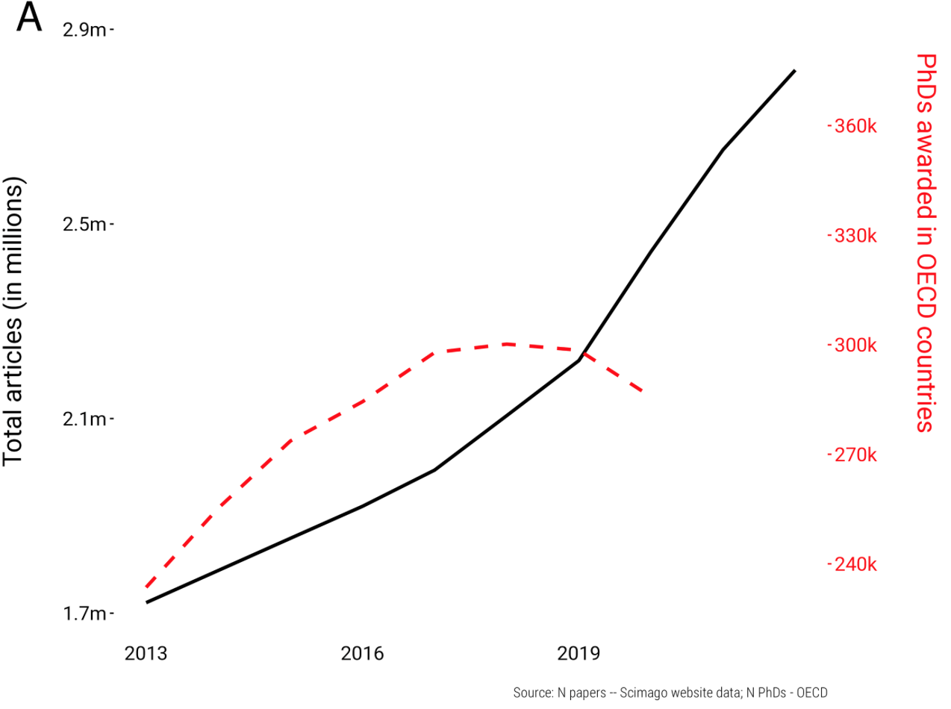
General background : the strain on scientific publishing
Mark A. Hanson, Pablo Gómez Barreiro, Paolo Crosetto, Dan Brockington; The strain on scientific publishing. Quantitative Science Studies 2024; 5 (4): 823–843. doi: https://doi.org/10.1162/qss_a_00327

Slide 5
The importance of data in dealing with AI systems
Louis Martin, Benjamin Muller, Pedro Javier Ortiz Suárez, Yoann Dupont, Laurent Romary, et al.. CamemBERT: a Tasty French Language Model. ACL 2020 - 58th Annual Meeting of the Association for Computational Linguistics, Jul 2020, Seattle / Virtual, United States. ⟨10.18653/v1/2020.acl-main.645⟩. ⟨hal-02889805⟩
Julien Abadji, Pedro Javier Ortiz Suárez, Laurent Romary, Benoît Sagot. Ungoliant: An Optimized Pipeline for the Generation of a Very Large-Scale Multilingual Web Corpus. CMLC 2021 - 9th Workshop on Challenges in the Management of Large Corpora, Jul 2021, Limerick / Virtual, Ireland. ⟨10.14618/ids-pub-10468⟩. ⟨hal-03301590⟩
CamenBERT vs. OSCAR
    CamemBERT: based on Facebook’s RoBERTa model released in 2019. It is a model trained on 138GB of French text;
    OSCAR: the underlying (multilingual – 166 languages) corpus: based on common crawl, cleaned, sorted per language, with high-performance data pipelines
    CamemBERT is cited; OSCAR is used ;-)
    But OSCAR is under threat… (presse régionale: la ligne maginot à l’envers)
Making such data accessible is a strain
  Documenting
  Hosting
  Delivering in the appropriate formats
  Licencing
Dealing with specialized resources such as publications

Slide 6
Consequences for our institutions (and states)
Policies
Ensuring that clear workflows are defined to provide full accessibility to research productions
Open science at the service of such policies
Infrastructures
Ensuring a proper governance of research productions
… and related services
Integrated vision for future AI for science programs
One example: AIKO

Slide 7
Scientific information policies

Slide 8
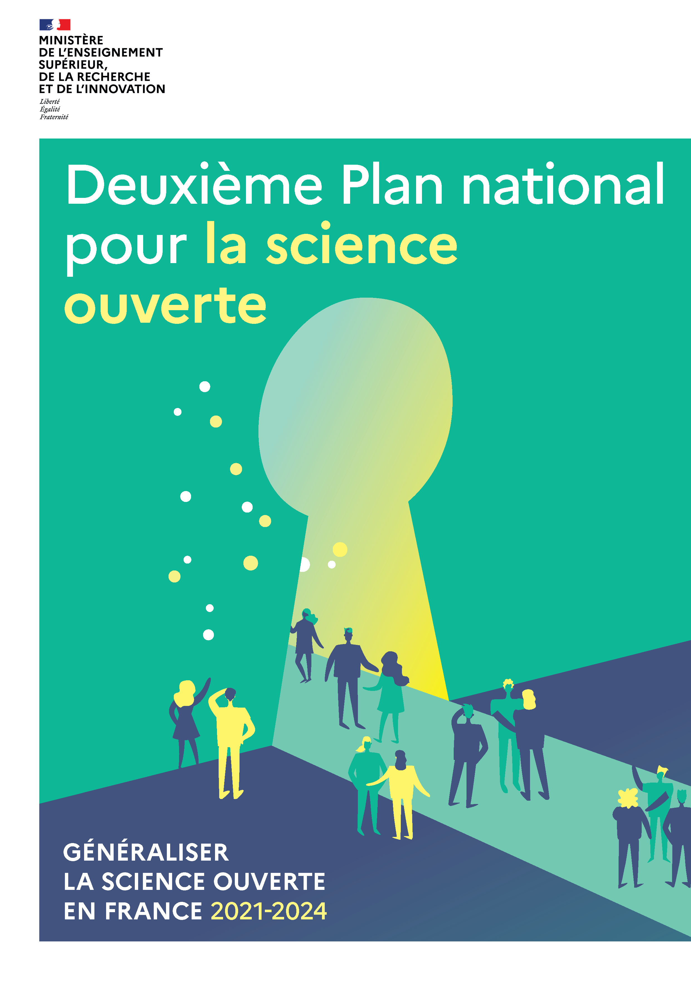
Open science: (French) national context
2016: Loi pour une république numérique (Lemaire)
  Allows self archiving with maximal embargo periods for accepted authors’ manuscripts
  Open data became mandatory for all publicly funded data, including research data
2018: Premier plan national pour la science ouverte
  Creation of French Open Science Committee
  Setting up a National Open Science Fund
2021: Deuxième plan national pour la science ouverte
  New action plan with 70+ items
  The pillars of open science: publications, research data, research source codes and software, transforming scholarly practices
https://www.ouvrirlascience.fr/second-national-plan-for-open-science/

Slide 9
Scientific information and open science — why do we need national and institutional policies?
Supporting researchers in managing and communicating scientific research productions
  Publications, data, software, methods
  At the service of science and mankind
Impact
  Visibility, citability, measure
Scientific transparency
  Proving, comparing, reproducing
Quality
  Formats, metadata, authorities
  Researchers/library specialists
Budget control
  Subscriptions, APCs, investments
Ensuring our (digital) sovereignty
  Setting up a corpus of our research productions
  Sustainable public infrastructures, text and data mining, indicators

Slide 10
Inria scientific information policy in concrete terms
Deposit mandate on all scientific publications (in HAL, CC-BY)
  Condition to appear in annual research reports
  Encouragement towards preprints
Central budget for APCs
  Forbidding hybrid open access
  Publisher’s PDF to be deposited in HAL (with equal licence)
  Management of a national dashboard of costs and journals (OpenAPC)
  No refunding requests to funders (FR, EU)
Engaging in developing new publication models and infrastructure
  Editorial support to Episciences based journals
  Investment and support to Software Heritage
  Editorialization (IFIP DL, conferences)
Research data support group
  Data management plan, support to the use of the new Recherche Data Gouv infrastructure
  National network of scientific contacts/champions for research data
  Preventing data set deposit on journal platforms
Printed material as disposable goods
  Creation of a central collection of reference works
  On going digitization of legacy publications (on HAL)
Engaging in text and data mining
  Contribution to the national open science monitor
  Software and data set citations
  … more to come
See an overview under: https://www.inria.fr/en/open-science-inria-role

Slide 11
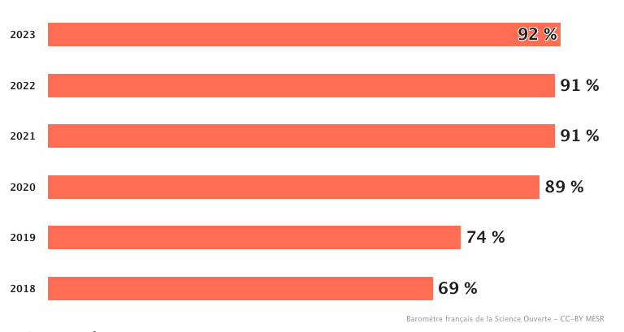
What we achieved at Inria…
11

Slide 12
What can we do with all this?

Slide 13
Text and Data mining of scientific documents
Exploring all aspects of a document
  Meta-data (title, authors, abstract, keywords)
  Bibliographic references (list, anchors in the text)
  Full text structure (divisions, paragraphs, figures, tables)
  Scientific objects (stellar objects, molecules, etc.)
A wide range of possible applications
  Improving information retrieval tools
  Linking documents (bibliography, similar content)
  Building up databases of scientific knowledge
  Automatic construction of scientific hypotheses
13

Slide 14
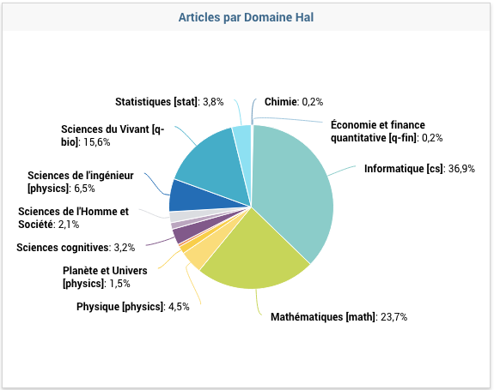
A variety of views on our scientifique production

Slide 15
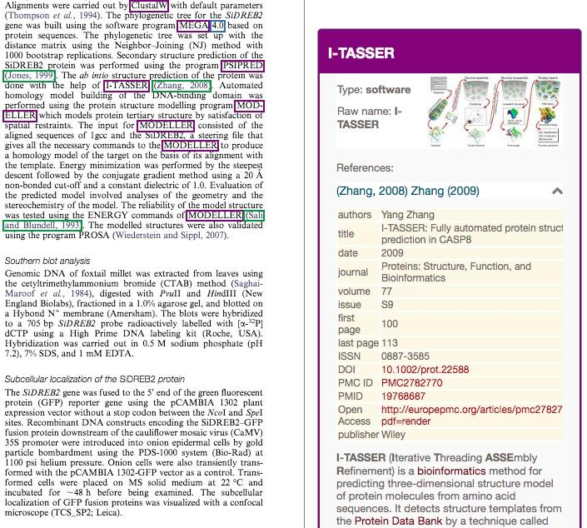
Mining full-texts to detect mentions to datasets and software
Innovative approach based upon the use and development of machine learning tools
  GROBID: full-text structuring
  Softcite: software mention detection
  Datastet: data set mention detection
Automatic characterisation of mentions: usage / production or creation / sharing
Notes:
IA entraînée sur des modèles de ML. Outils libres, toujours

Slide 16
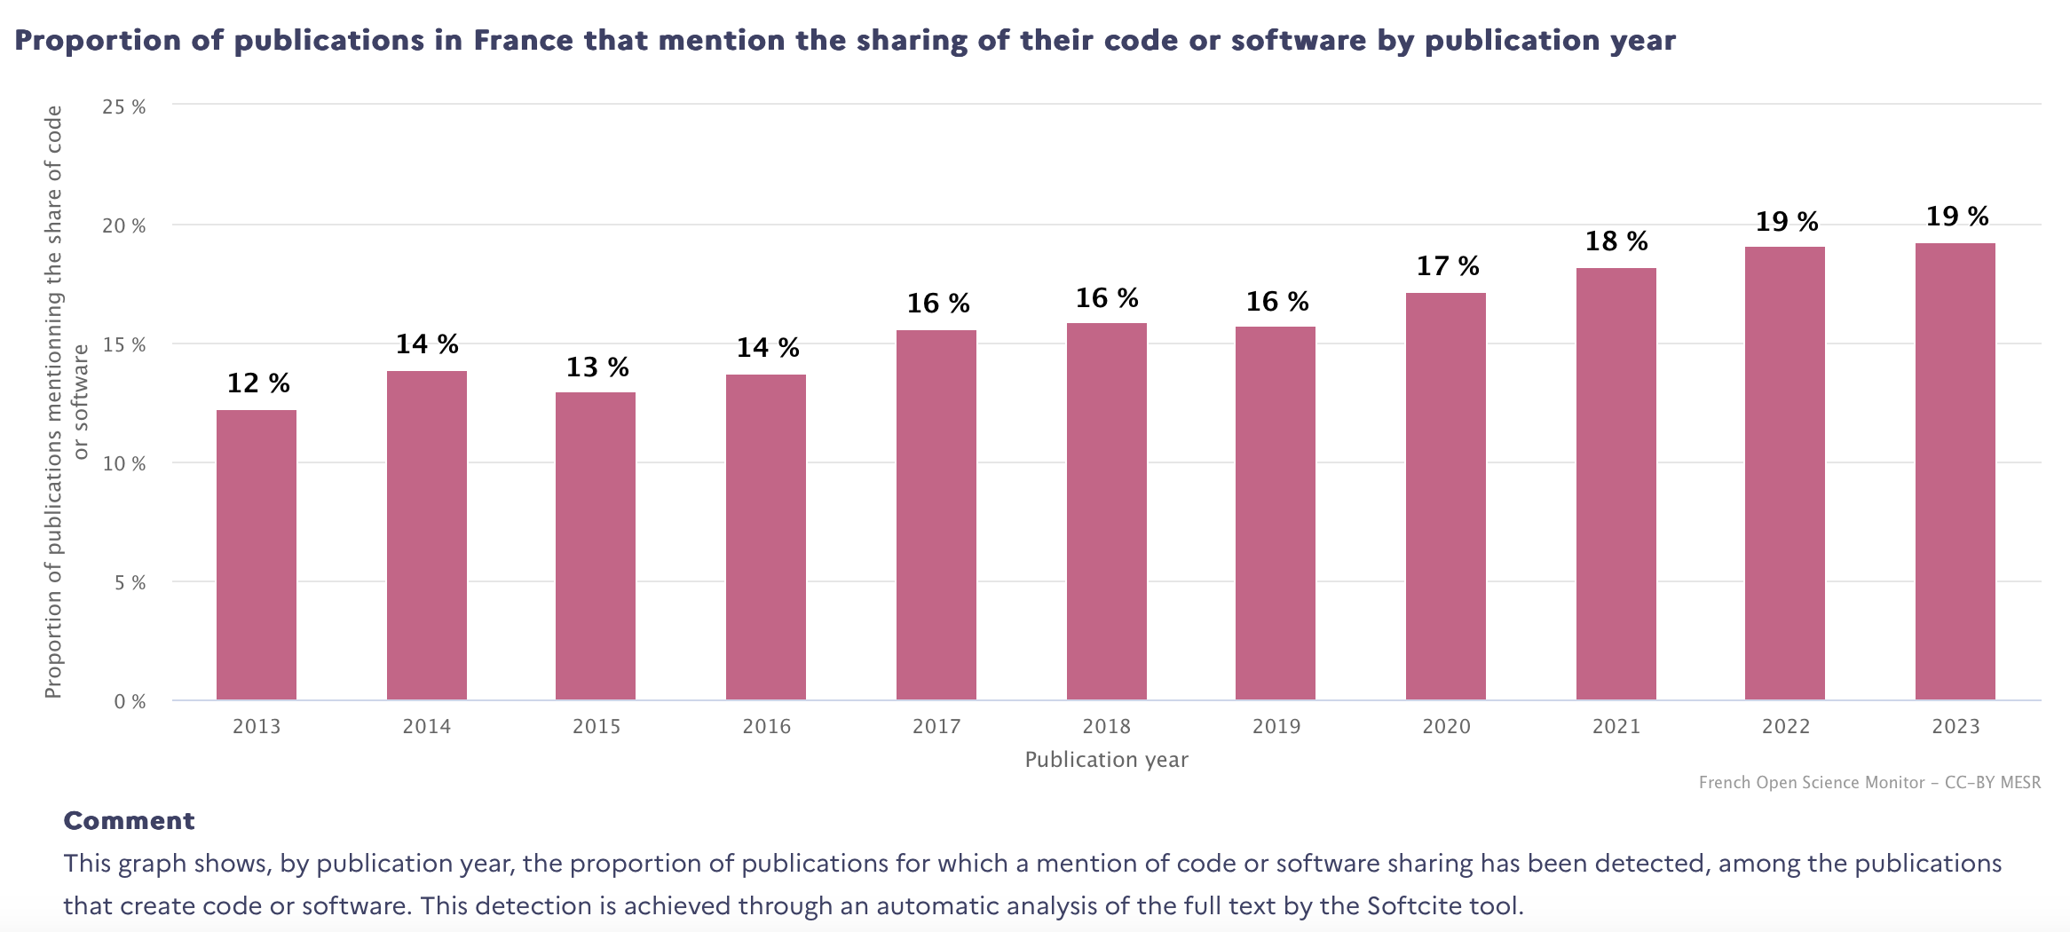
Software, the view from the French open science monitor (2025 release)
16

Slide 17
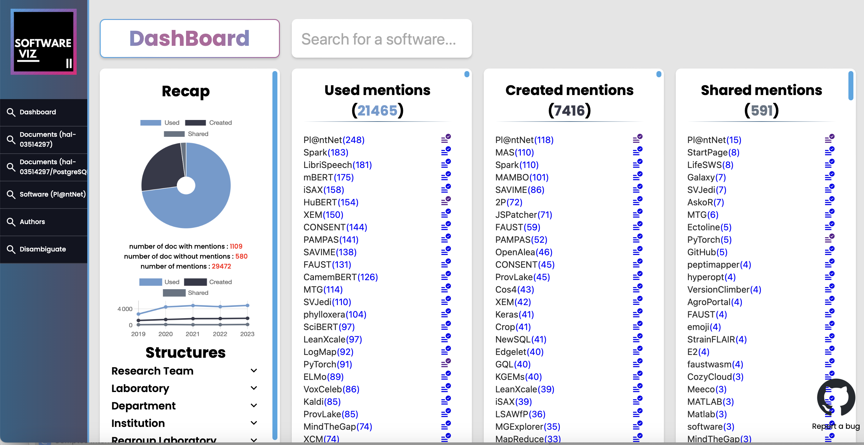
Application: visualising software references with Software-Viz
17

Slide 18
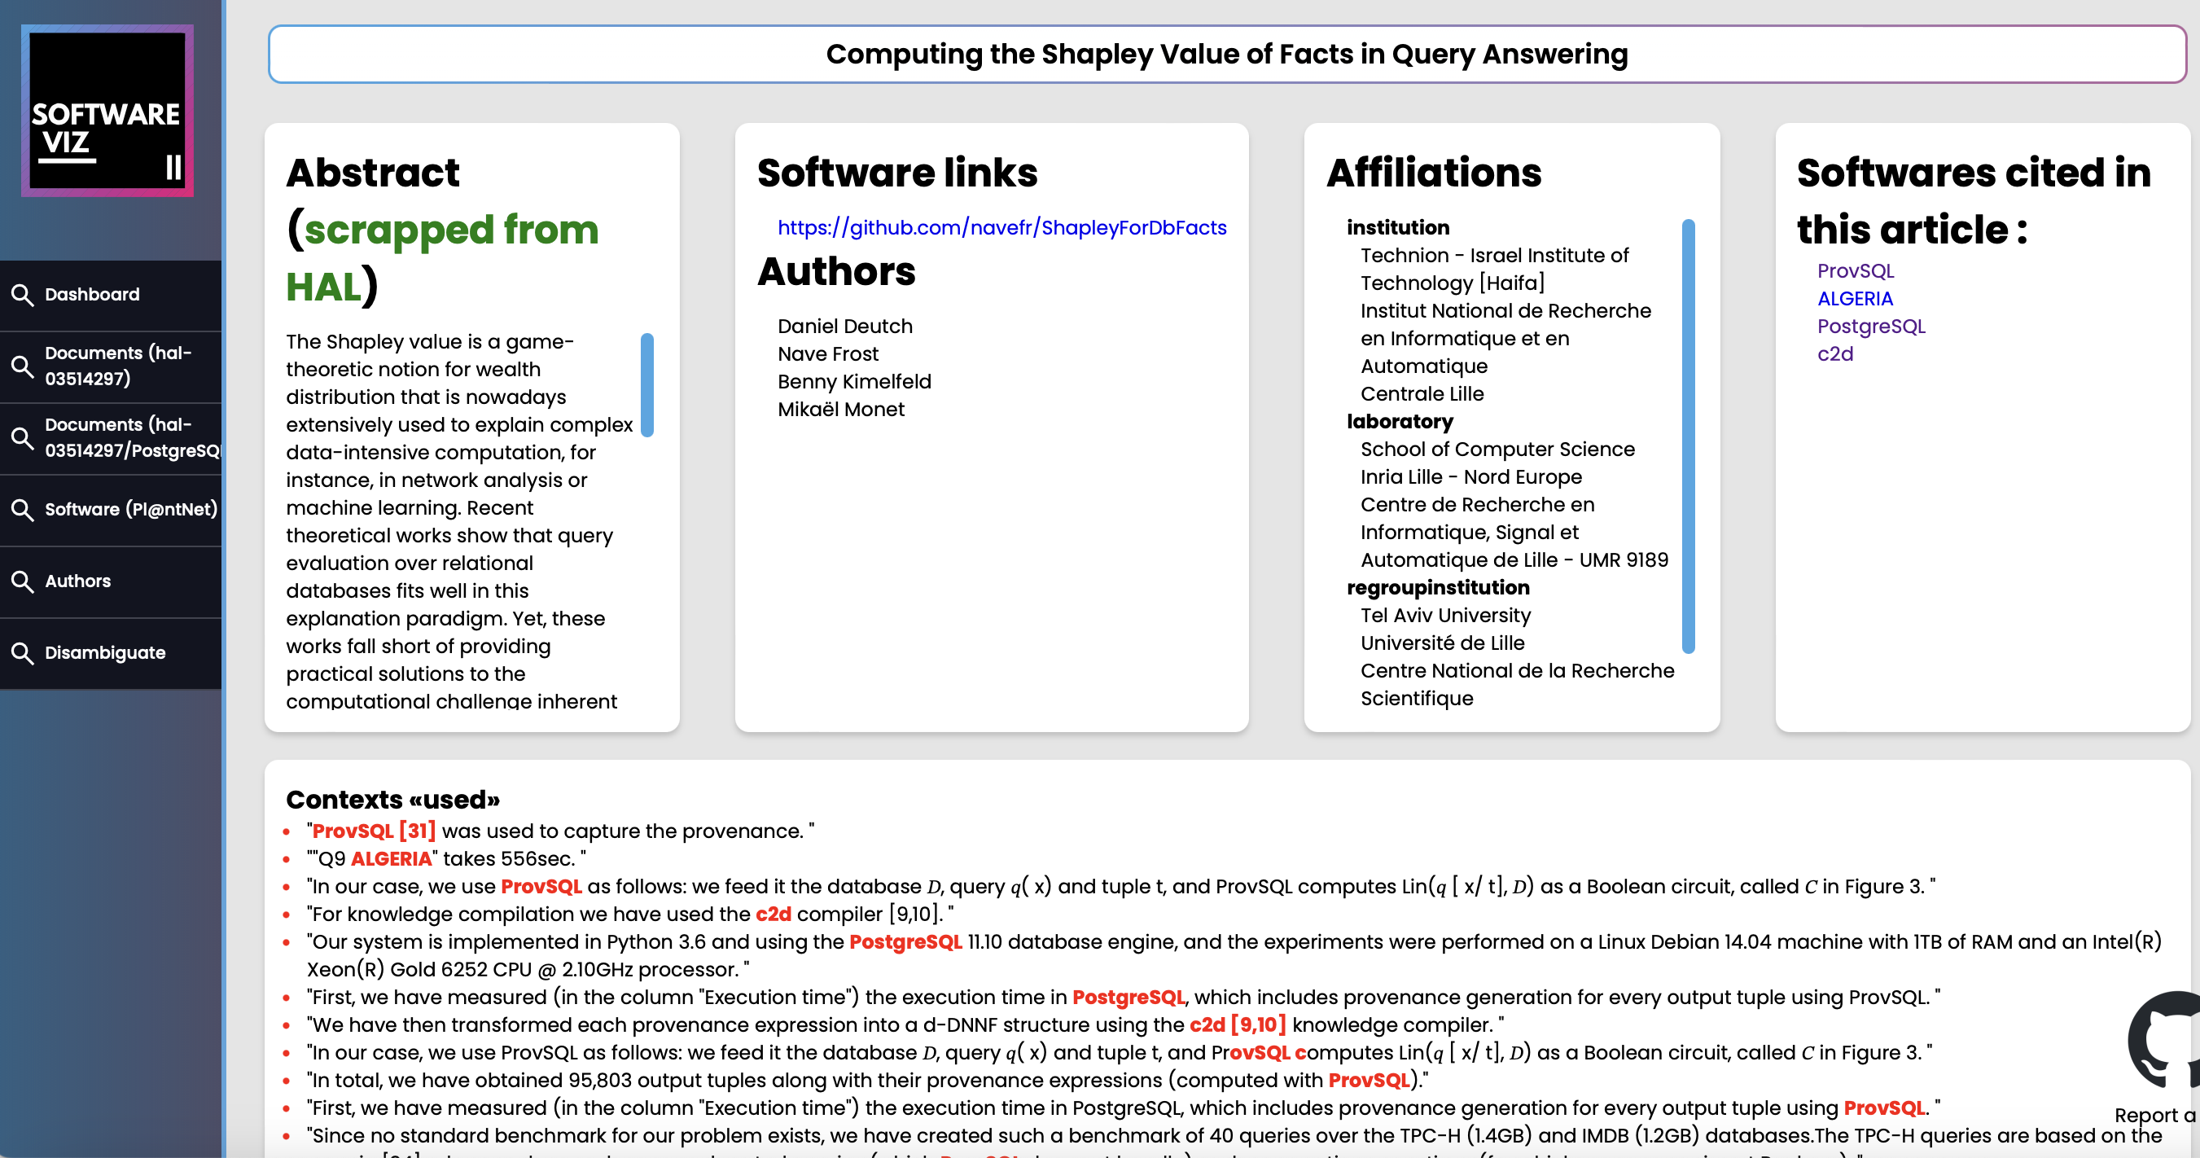
Close reading of software in a publication with Softcite/Software-viz
18

Slide 19
Towards a national research program on AI for publications

Slide 20
Building up sovereign AI systems for scientific publications – the AIKO program
Context :
    French national program agency on digital research
    Lead : Inria
Designing a specific program on “AI for publication knowledge” (AIKO)
    Co-lead: CIRAD & Inria
    Publications to train/fine tune AI systems — using AI for managing publication content
    Gathering a fair amount of existing NLP teams in France
    Setting up an infrastructure for experimentation with as much content as possible
What kind of AI tools/components do we want for science in the future ?

Slide 21
What we are aiming at…
Recognition and identification of information
Entities, events & relations, terminology, structured content
Content analysis
Arguments, trends, bias
Content accessibility
Translation, simplified formulation, assistance to writing,
Multimodality
Text & image, experimental data and models, software and data artefact
IP issues, competition camps,
prospective seminars
Data workbench
Standardised integrated format (metadata & XML full text), LLM ready version, bibliographic citations, software entities
Additional annotation as needed for experimentation campaigns
Data sources
French open platforms: HAL, Persée, OpenEdition, PhD theses
Licenced materiel (ca. 20 million documents)
Open material: Unpaywall identified documents, Europe PMC preprints

Slide 22
Technical and intellectual infrastructures
Existing national/international infrastructures
    HAL (French national publication repository), Recherche Data Gouv (Data repository),
    Software Heritage (International archive for software source code)
    Heavy load from AI bots
Infrastructures for publication content management
    Istex (INIST-CNRS)
    Initially intended for licenced material
    Extending its scope to a variety of publication objects
    Already integrates a normalisation workflow with GROBID
    Extension: software mentions (SoftCite), data set mentions (Datastets)
    Need to couple this with decent hosting and computing capacities
Improving intellectual property guidelines for the management of scientific knowledge
    Licencing of primary sources, standard reuse clauses in subscription contracts, IP status of annotated data, software, models

Slide 23
Publication sources
Integrating a wide variety of publication sources
    Licenced material (national licences)
    Open content (HAL, arXiv, Europe PMC, Unpaywall)
    PhD theses, patents, standards
    Focus on well-identified and available sources
    Licencing: impact on the possible dissemination of results
Data preparation – data quality
    Integrating all information sources: metadata and full text
    Normalising data representations
    Structured representation of content (XML-TEI) (Grobid suite)
    Tokenised version for LLM training/fine-tuning
Annotated data sets
    Comparability – standardised annotation schemes
Joglekar, A., & Umesh, S. (2024). Shiksha: A Technical Domain focused Translation Dataset and Model for Indian Languages. arXiv preprint arXiv:2412.09025.

Slide 24
Issues with open access content – Retex from Istex (INIST-CNRS)
Dump from Unpaywall (juin 2023 – 24 M docs)
  Structured with GROBID (with bibliographical references), consolidated with CrossRef information
Heterogeneity
  Licences
  Document typology
  Language
  Publication dates
  Openness status (green, gold, hybrid etc.)
Not all content can be integrated in Istex for TDM purposes
  First step is an organisation of content as homogeneous bundles
    Plos, SciELO, Copernicus, University presses, etc.
    Thematic fields for smallish sources (SSH, health, physics, life sciences, etc.)
  Dedicated upload — 7 M documents
    Articles, chapters, e-books — no preprints, dubious publishers (DOAJ as a reference)
    Licences: CC-0, CC-BY, CC-BY-ND
24

Slide 25
Take aways
The necessity of a coherent strategy with clear principles in the various domains of involvement
  Research management
  Scientific information policies
  Contribution to infrastructures
  Contribution to standards
Importance of working as a network of institutions
  Sharing capacity, data and infrastructure
    E.g. Istex
  Defining joint conditions of reuse
Anticipate on the strong consequences of the deployment of AI on researchers’ work
  Sovereign management of research productions
  Thinking the future of publication and peer review
  Keep environmental constraints in mind
    More specialized and interpretable tools than generic LLMs

Slide 26
Merci.

